Slide 1
Analysis for Stocks Value of Investment
MIS637 Knowledge Discovery and Data Mining
Submitted by: Mengyao Shen
Guided by: Prof. Mahmoud Daneshmand

Slide 2
Agenda
Introduction
K-Means Clustering
Data Understanding
Collect Data
Dataset Description
Sample Raw Data
Data Preparation
Data cleaning
Modeling
Result Analysis

Slide 3
Introduction
The U.S Stock Market has began to get rid of the credit crisis this year. S&P 500 increased to 1800, Dow J index reached 16000. However, as approaching to the expected time of QE* reduction, investors still have concerns while investing in stocks.
This project will mainly choose food, beverage, and tobacco stocks as target stocks; use stock related indexes as dimensions to analysis and filter stocks.
The goal of the project is provide investors references for stocks with values of investment and make decision for stock investment.
*QE: Quantitative Easing is an unconventional monetary policy used by central banks to stimulate the economy when standard monetary policy has become ineffective.

Slide 4
K-Means Clustering
The K-Means Clustering is an effective algorithm for finding clusters in data. It can be used to partition the input data set into k clusters.
In this case, we will use K-Means Clustering to classify stocks by using related indexes as dimensions. And based on the analysis of each cluster’s characters to provide investment suggestions.

Slide 5
Data Understanding: Collect Data
Data Sources: http://biz.yahoo.com/p/3conameu.html
The raw data for stocks are from 9 subsectors in consumer goods:
Beverages-Brewers, Beverages-Soft Drinks, Beverages-Wineries & Distillers, Confectioners, Dairy Products, Food- Major, Diversified, Meat Products, Cigarettes, and Tobacco Products.
There are more than 800 sets of data been collected.
Each set of data included 6 variables, which will be used as 6 dimensions：1 Day Price Change%, P/E, ROE％, Long-Term Debt to Equity, Net Profit Margin%, Price to Free Cash Flow.

Slide 6
Data Understanding: Dataset Description (1/2)
There are 6 variables in each dataset.
1 Day Price Change%
Percentage price change is generally the norm for computing asset performance.
P/E
The price-to-earning ratio, defined as market price per share divided by annual earnings per share. It reflects the ability of the stock to make a profit.
ROE％
Return on Equity measures a firm’s efficiency at generating profits from every unit of share holders’ equity, and shows how well a company uses investment funds to generate earnings growth. The higher ROE means the stock generally could bring the investors more profits than the lower one.
* Definitions referred from Wikipedia

Slide 7
Data Understanding: Dataset Description (2/2)
Long-Term Debt to Equity
D/E indicates the relative proportion of shareholders’ equity and debt used to finance a company’s assets. A company with too high debt to equity shows that the company has the high risk of default.
Net Profit Margin%
Net profit Margin refer to a measure of profitability. The higher net profit margin illustrate the stronger the profitability.
Price to Free Cash Flow
FCF shows how much cash can be extracted from a company without causing issues to its day to day operations. It’s useful to compare the company’s past levels of price-to-free-cash flow along with comparing the average within its industry. The higher this measure, the more expensive the company is considered
* Definitions referred from Wikipedia

Slide 8
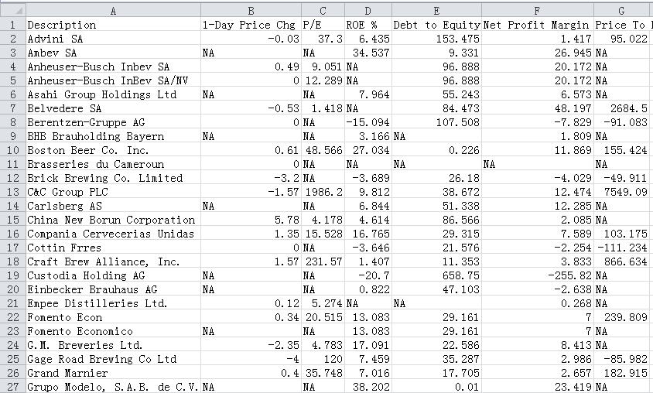
Data Understanding: Sample Raw Data

Slide 9
Data Preparation: Data Cleaning (1/7)
Combine Raw Datasets
Since we have 9 spreadsheets for all the subsectors, we need to combine all the raw datasets into one sheet. Every spreadsheet has the same variables; and all the variables are numeric, we can directly combine the datasets.
Missing Data
After observe the raw data, all the data are unified and we can see there are many values are missing (NA) in the raw data spreadsheets. We need to delete the datasets which have the missing value in variables.

Slide 10
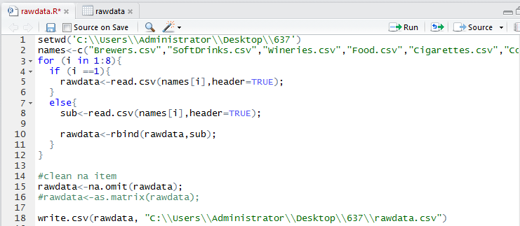
Data Preparation Data Cleaning (2/7)
We use R to combine raw data spreadsheets, delete invalid values and export data to a new data csv. document

Slide 11
Data Preparation: Data Cleaning (3/7)
After combine the spreadsheets and handling the missing data, there is 169 datasets left. So we will analysis this 169 stocks which have valid data for analyzing.
For the convenience of next step modeling:
Use acronym of each variable
Use Number to represent name of each company

Slide 12
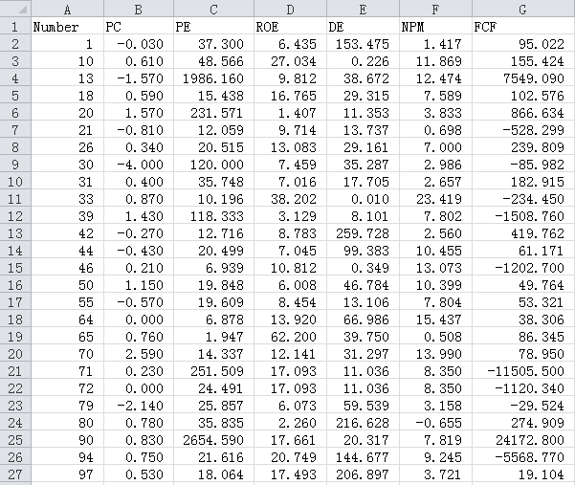
Data Preparation: Data Cleaning (4/7)
Get the all the clean data in a sheet

Slide 13
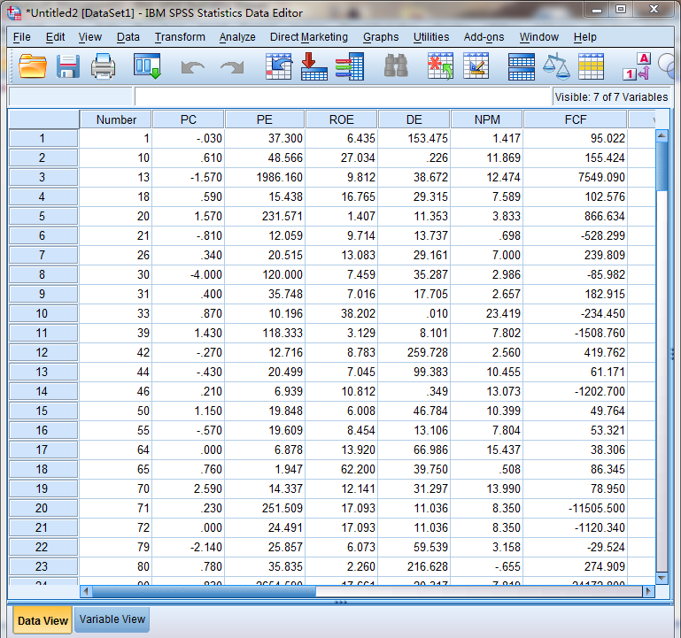
Data Preparation: Data Cleaning (5/7)
Import data into SPSS

Slide 14
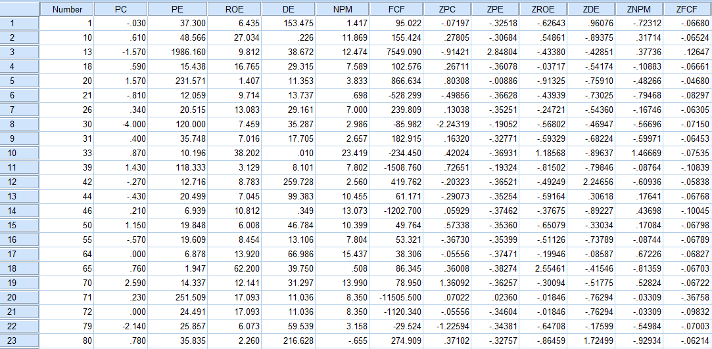
Data Preparation: Data Cleaning (6/7)
Use SPSS to get the Z-Score Normalization data

Slide 15
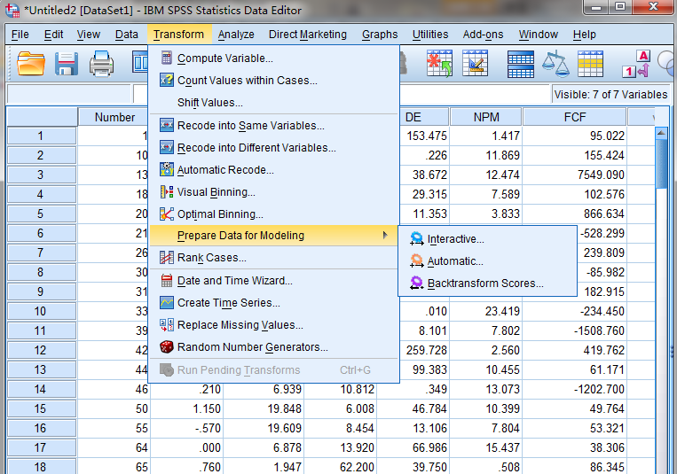
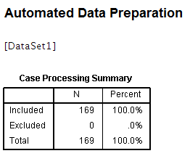
Data Preparation: Data Cleaning (7/7)
Use SPSS to Transform the current dataset, and make sure there is no data anomaly.

Slide 16
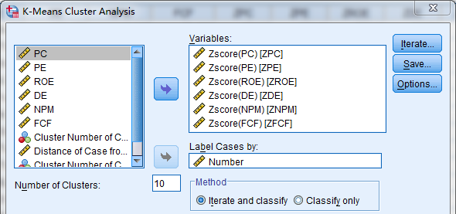
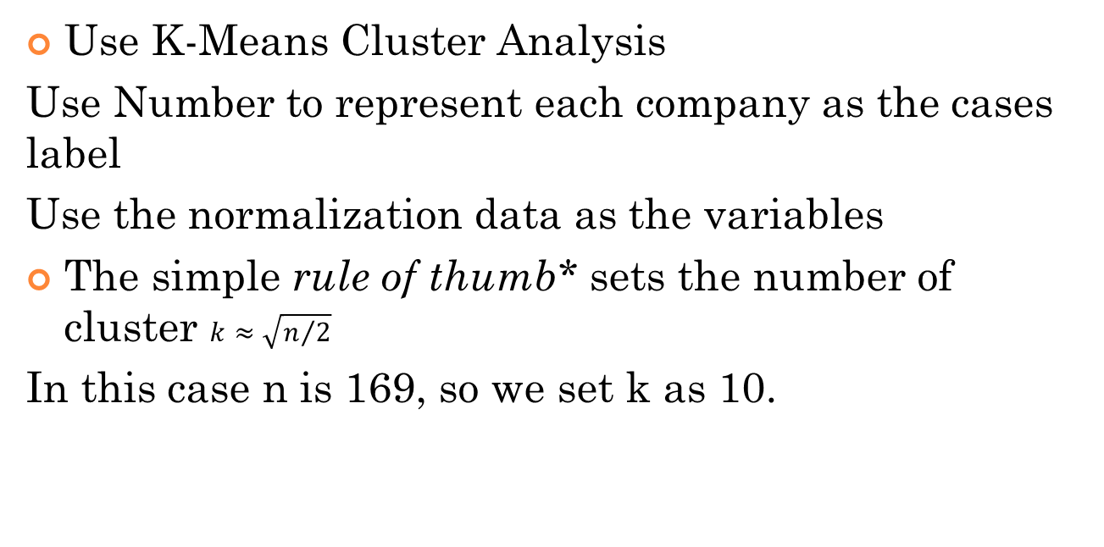
Modeling: Execution
Use K-Means Cluster Analysis
Use Number to represent each company as the cases label
Use the normalization data as the variables
The simple rule of thumb* sets the number of cluster $k≈\sqrt{n/2}$
In this case n is 169, so we set k as 10.
* Rule of thumb referred from http://en.wikipedia.org/wiki/Determining_the_number_of_clusters_in_a_data_set

Slide 17
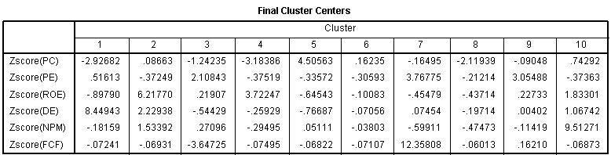
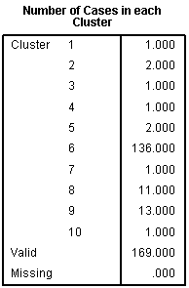
Modeling: Result (1/2)
Modeling: Result (1/2)
Observe the result of cluster, we can find that most of the company are centered in cluster 6

Slide 18
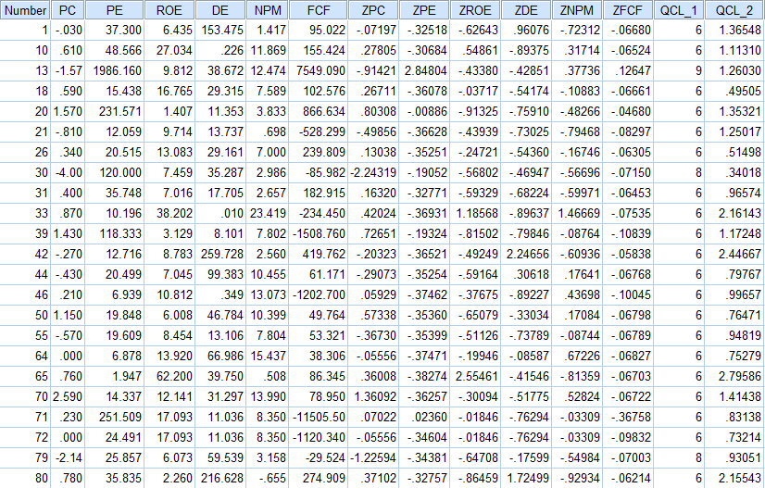
Modeling: Result (2/2)
Sample of Result
QCL_1 means the Cluster Number
QCL_2 means the Distance of Case from its Classification Cluster Center

Slide 19
Result Analysis
After cluster, 80% of the stocks are classified into Cluster 6. The stocks in other 5 clusters are exceptional.
After observe the data of the 33 stocks which are not in Cluster 6, we can find these stocks has at least 2 or more dimensions are out of the normal range. The 136 stocks in the Cluster 6, have at least 4 dimensions are in normal range.
Compare the values for each index that these 136 stocks have, with a new stocks in this industry that are not be taken into this analysis, we can estimate if the new stocks has the value for investment.

Slide 20
Recommendation
The 136 stocks in Cluster 6 have the values for investment. Can be recommended to investors.
The 33 stocks which are not in the Cluster 6 has anomaly in stock related indexes, investors should give careful consideration, and better not invest.
If investors want to invest a stock in the same industry which is not been analyzed in this study, they can directly compare each index of stock with the 136 stocks. If all the values of indexes are closing, it means this stock can take consideration to invest.

Slide 21
Reference
http://en.wikipedia.org/wiki/Quantitative_easing
http://www.investopedia.com/terms/p/price-change.asp
http://en.wikipedia.org/wiki/Price%E2%80%93earnings_ratio
http://en.wikipedia.org/wiki/Return_on_equity
http://en.wikipedia.org/wiki/Debt-to-equity_ratio
http://en.wikipedia.org/wiki/Net_profit_margin
http://en.wikipedia.org/wiki/Free_cash_flow
http://en.wikipedia.org/wiki/Determining_the_number_of_clusters_in_a_data_set

